Slide 1
Navadisha Montessori Foundation

Slide 2
We are 20 years old …

Slide 3
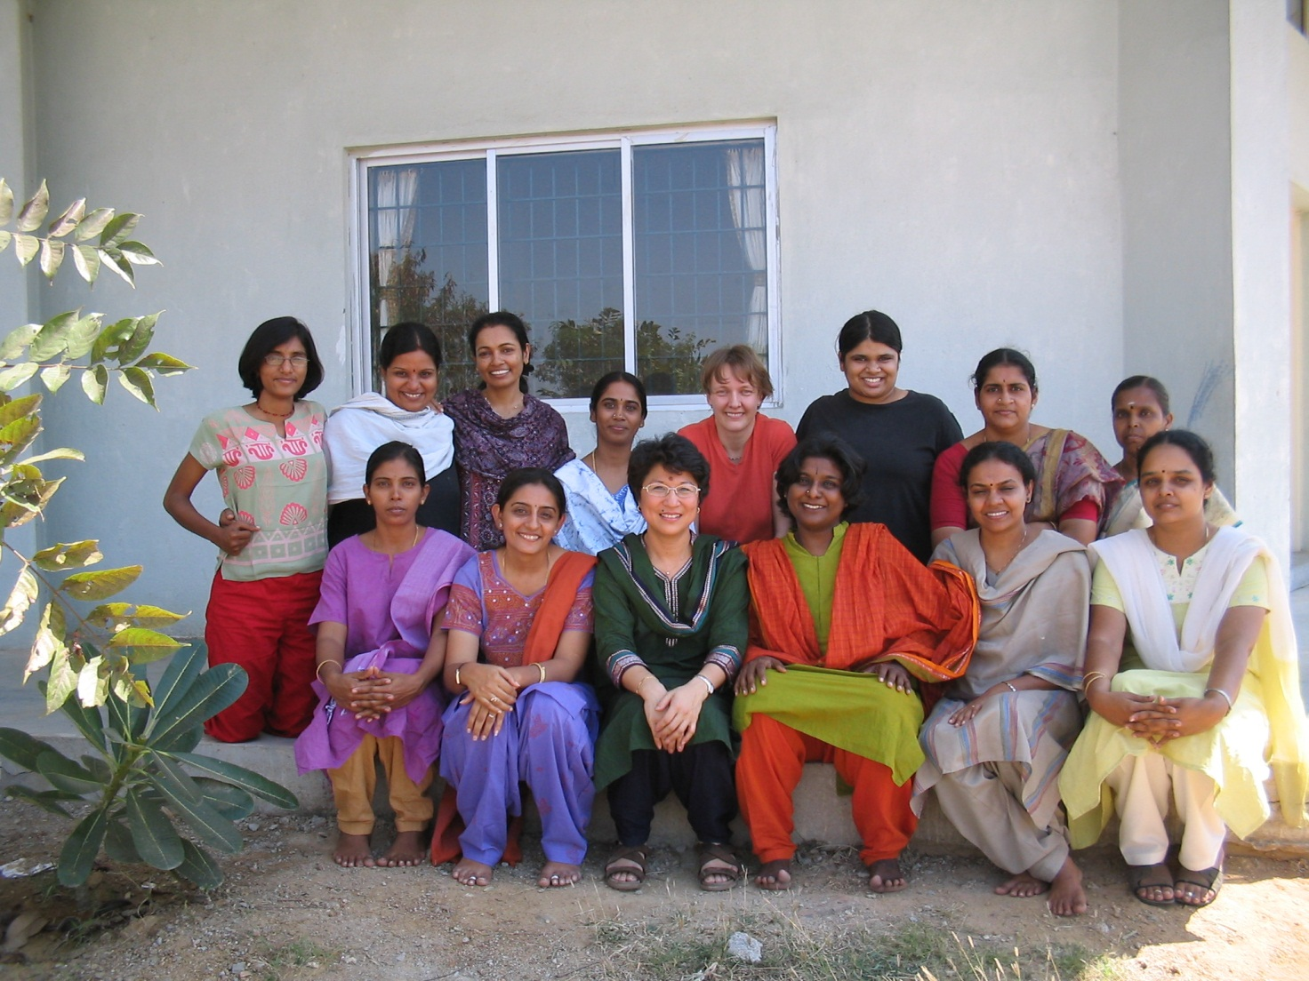
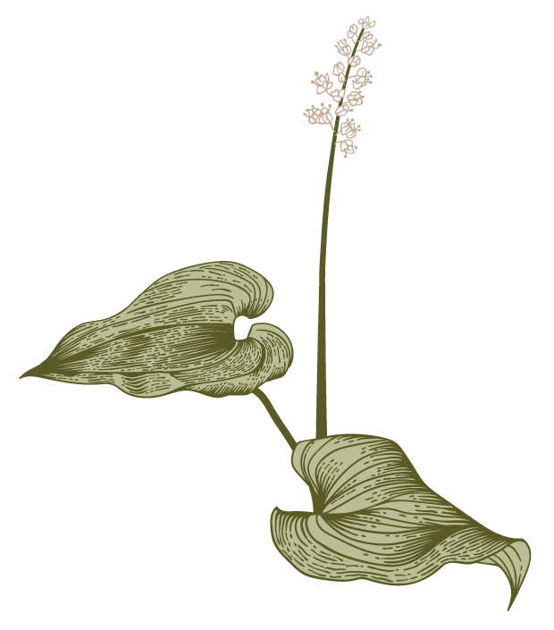
Year 01

Slide 4
The next phase of our development …

Slide 5
A new incarnation…

Slide 6
A new name …

Slide 8
A unit of Abacus Trust …

Slide 9
Moving to new premises …

Slide 10
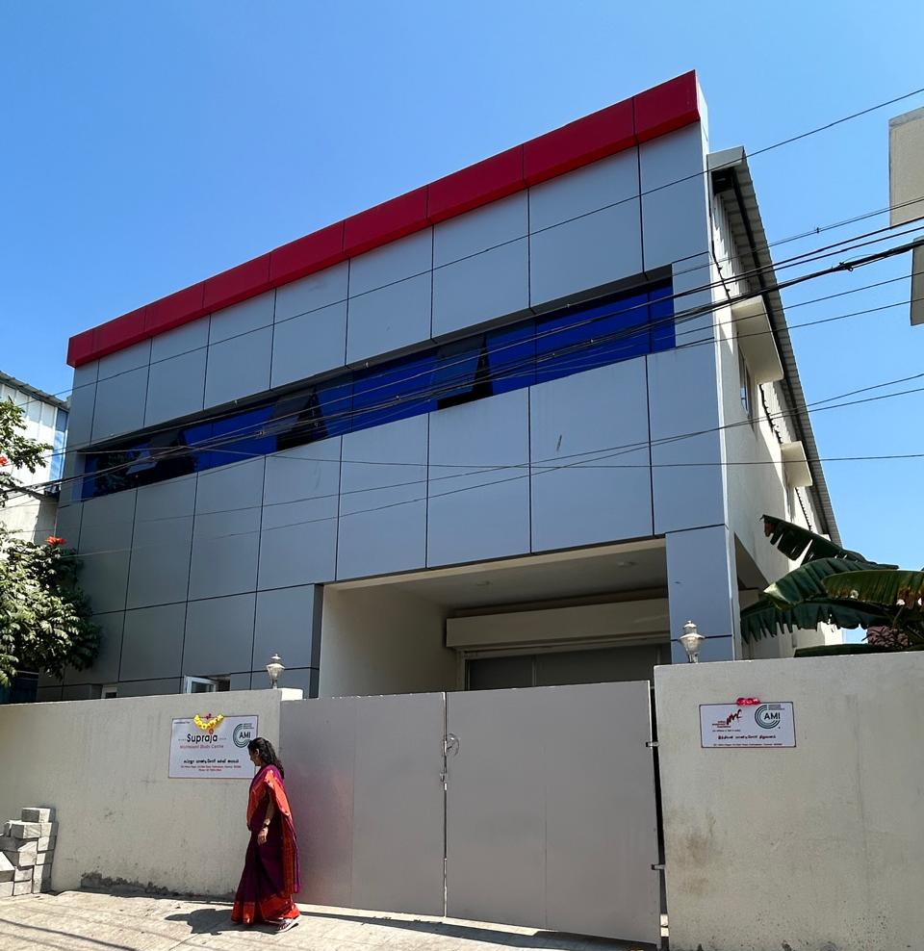
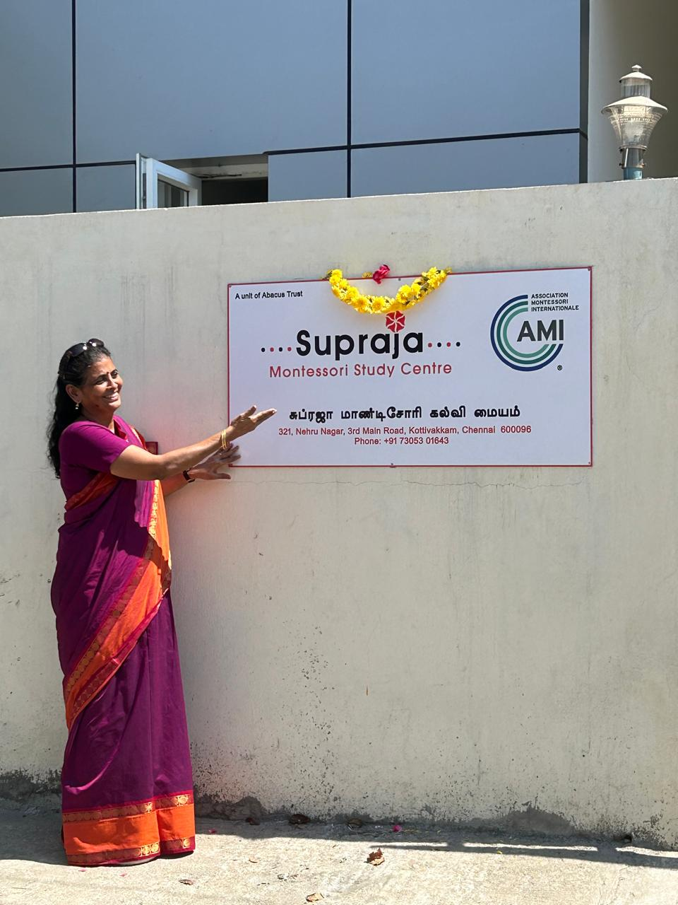

Slide 11
A new independence…

Slide 12
My vision of the future is no longer of people taking exams and proceeding on that certification from the secondary school to the university, but of individuals passing from one stage of independence to ahigher, by means of their own activity, through their own effort of will, which constitutes the inner evolution of the individual.
”
~ Maria Montessori

Slide 13
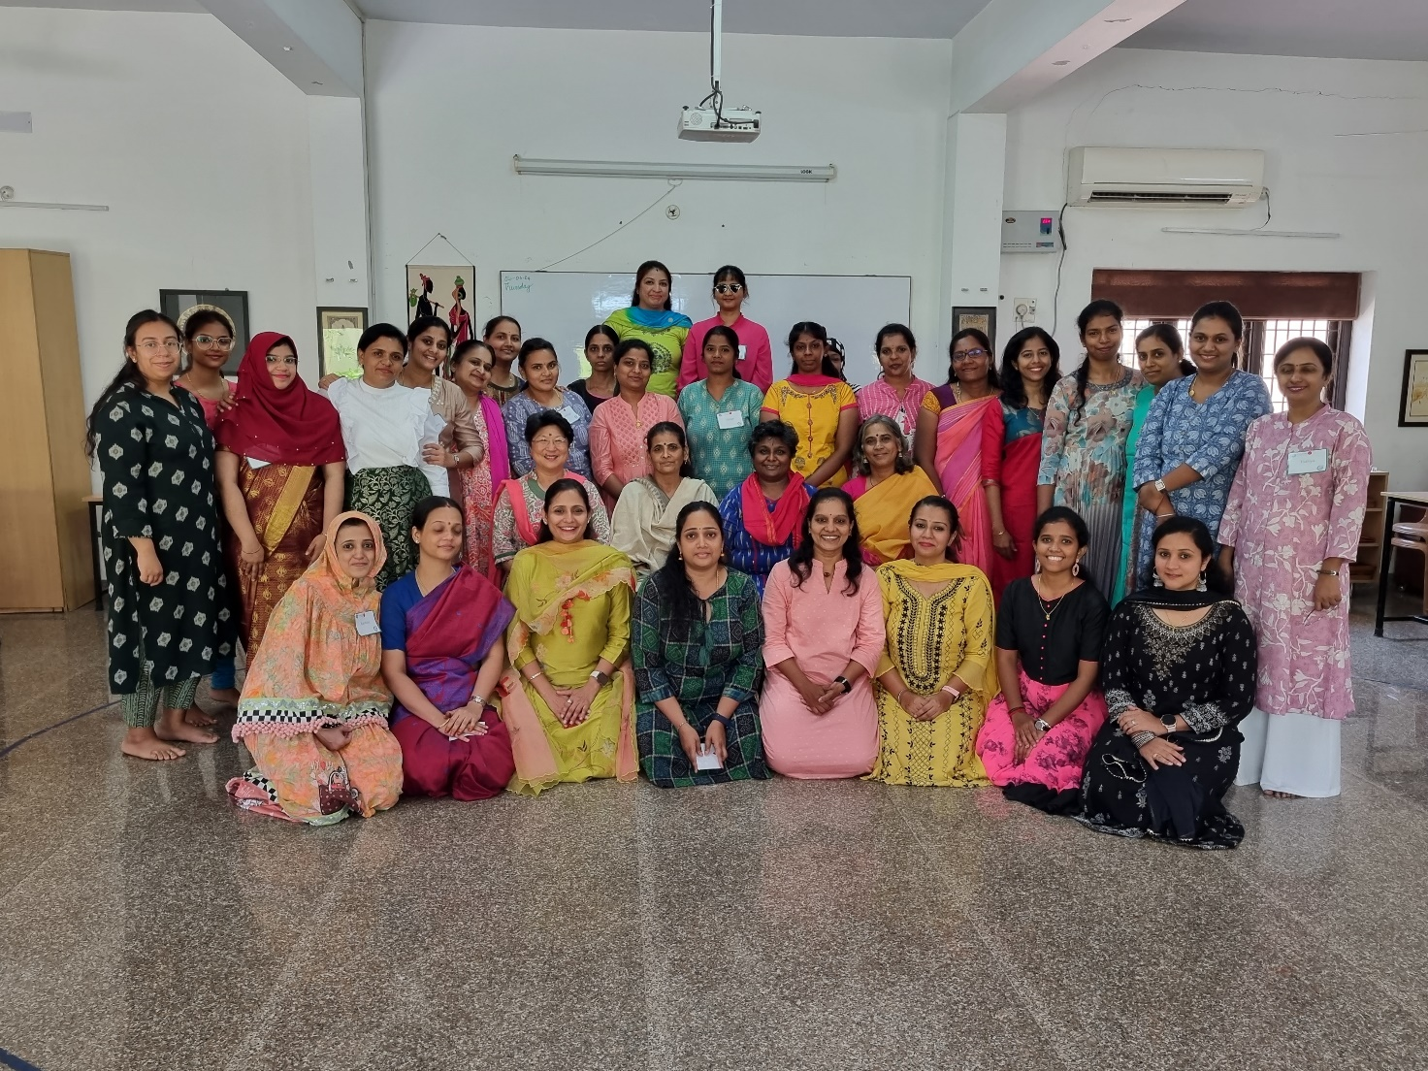
Year 20

Slide 14
20 years and counting …

Slide 15
Messages from your friends

Slide 16
Many Congratulations to Navadisha Montessori Institute on this milestone achievement. The work of Navadisha Montessori Institute has made a profound impact on countless students, educators and communities worldwide. As a proud alum, I am grateful for the transformative experience and invaluable skills I gained under your guidance. Here's to two decades of excellence in Montessori Training and many more to come Happy 20th Anniversary! - NMF 02, Vasumathi Srinivasan

Slide 17
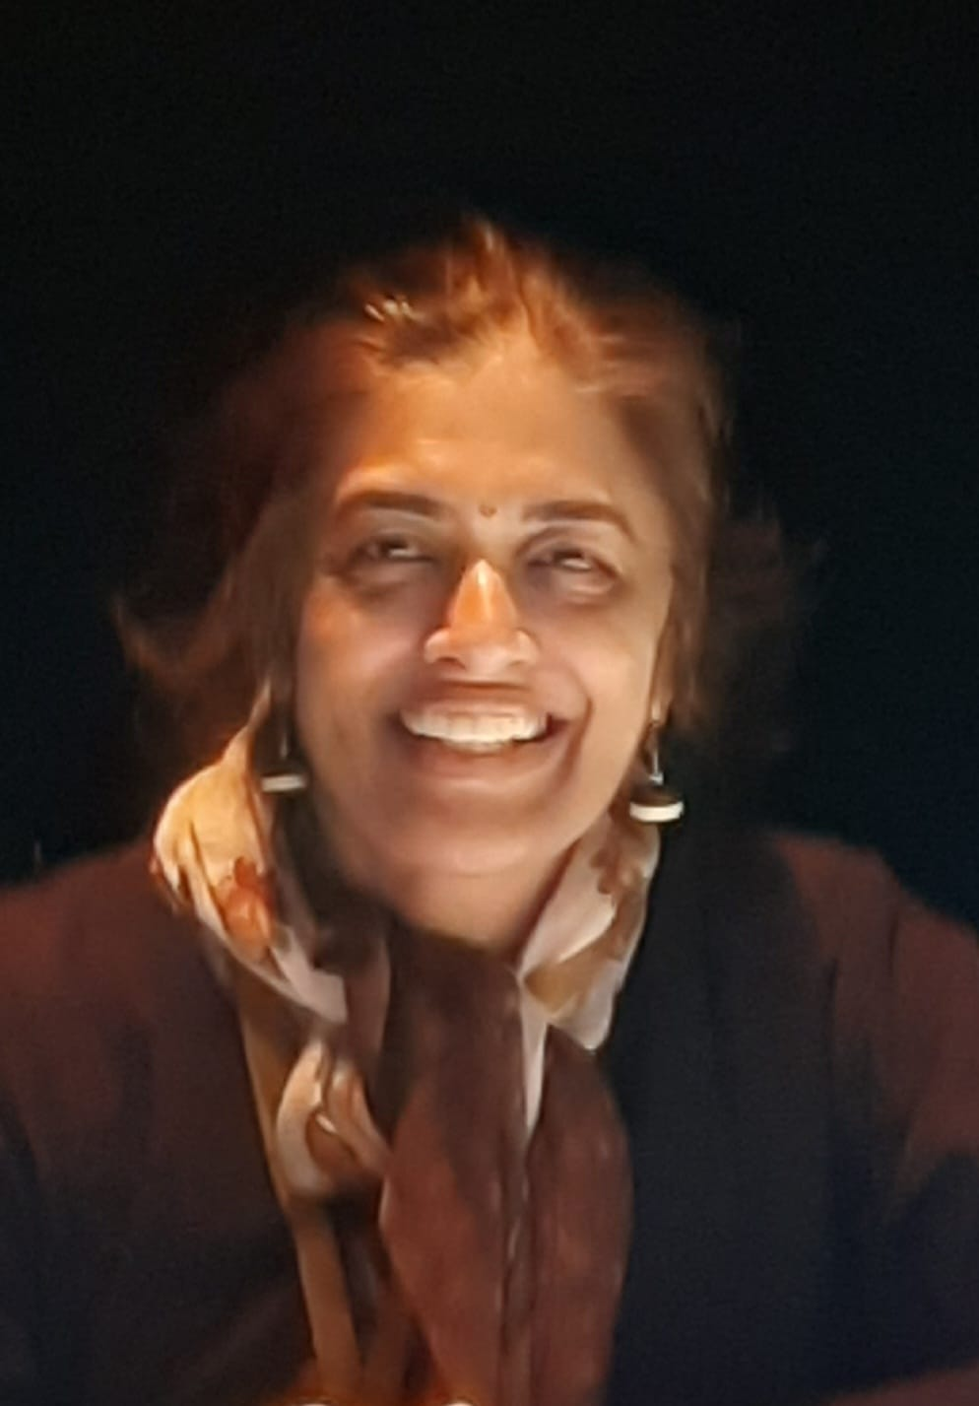
Thank you for giving me this opportunity to connect with everyone. I am presently in Bangalore and coordinating with Montessori Institute Bangalore and their school Kriyasthala in whichever capacity I can.... I think it was Aarthi from our batch who sent the nostalgic photo of our NMF 02 batch. Thank you Aarthi. Soon after I decided to recollect all the names in the group. I am in touch with many of them there....in one way or the other.... So here is saying a Hi to each of you....And very Best Wishes!!! - NMF 02, Shalini Thilak

Slide 18
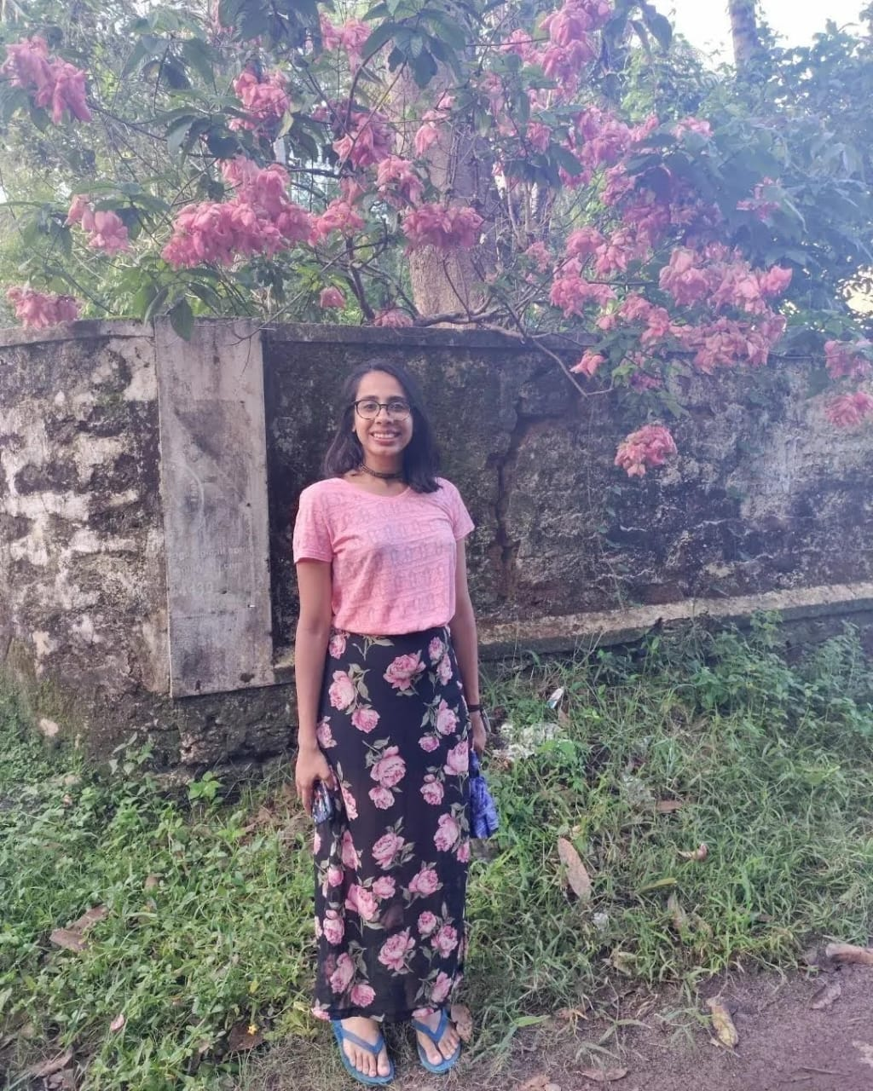
I cannot believe it has been four years already. I can still recall the blast of AC, the materials in the prepared environment and even smell the lemongrass oil. ‘Intensive’ is a mild word describing our diploma course. Often, I found it challenging and demanding. Yet, this very course has sparked an inner journey towards self-discovery and a curiosity for nature. In current times of AI and other technological advancements, I feel the need for the Montessori method even more. I have found great fulfilment as a Montessori guide and hope to continue growing in this path. - NMF 16, Mathangi Krishnamoorthy

Slide 19
A nice quote to be written here.
“
”
~ Maria Montessori

Slide 20
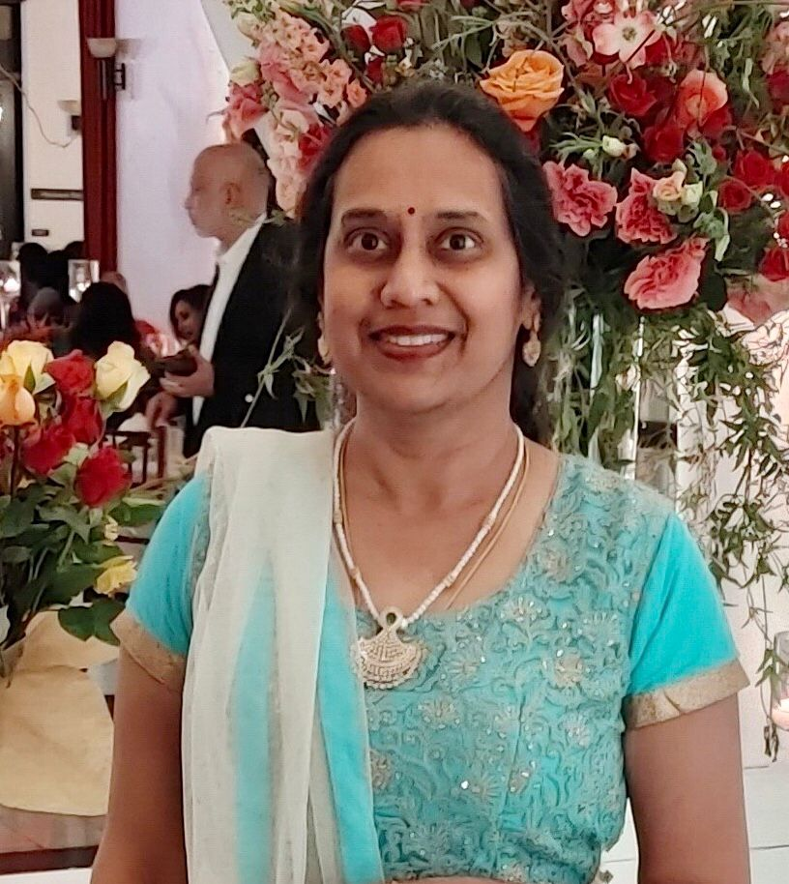
Congratulations to the Navadisha team on the 20th Anniversary of the training center. What a fantastic achievement! Rukku, your vision, perseverance, and tenacity for the Montessori education and the teacher training program is commendable. I’m so very proud of you and wish you and your staff continued success in your contributions to the Montessori community of Chennai, India, and the world. - KPMC, Aarti Shah

Slide 21
I want to express my heartfelt greetings and best wishes. It fills me with joy to see how our Montessori community continues to thrive and grow.
Even though I cannot be there physically, my thoughts and well-wishes are with you all. I cherish the memories we shared during our time together and look forward to hearing about the diverse experiences you all shared with children.
I wish you a fantastic gathering filled with laughter, camaraderie, and the spirit of Montessori education. Let's continue to cherish our bond and support each other in our endeavors.
- NMF E 07, ES Pavithra

Slide 22
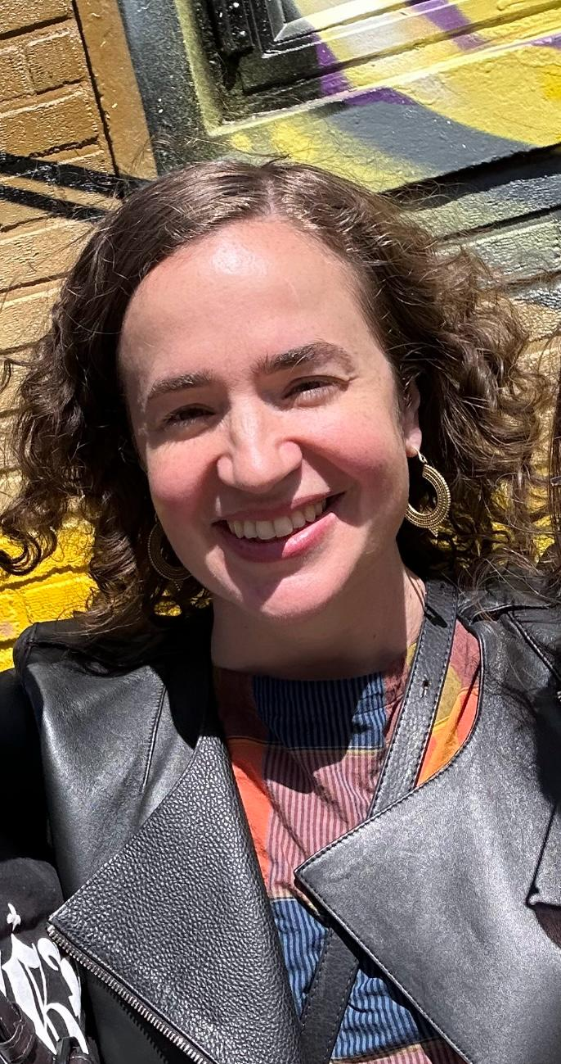
"Hello to all at Navadisha. Thank you for thinking of me - I would love, love, love to be there. Unfortunately we have many meetings at AMI, otherwise I would have tried to make it. I actually cannot believe it has been 20 years for Navadisha. It’s quite incredible. I keep the best of memories with me - I think we all do! I will be thinking of you all. Please send us photos and hope to see you all soon." xxx ♥♥♥ - NMF 02, Emily Dew

Slide 23
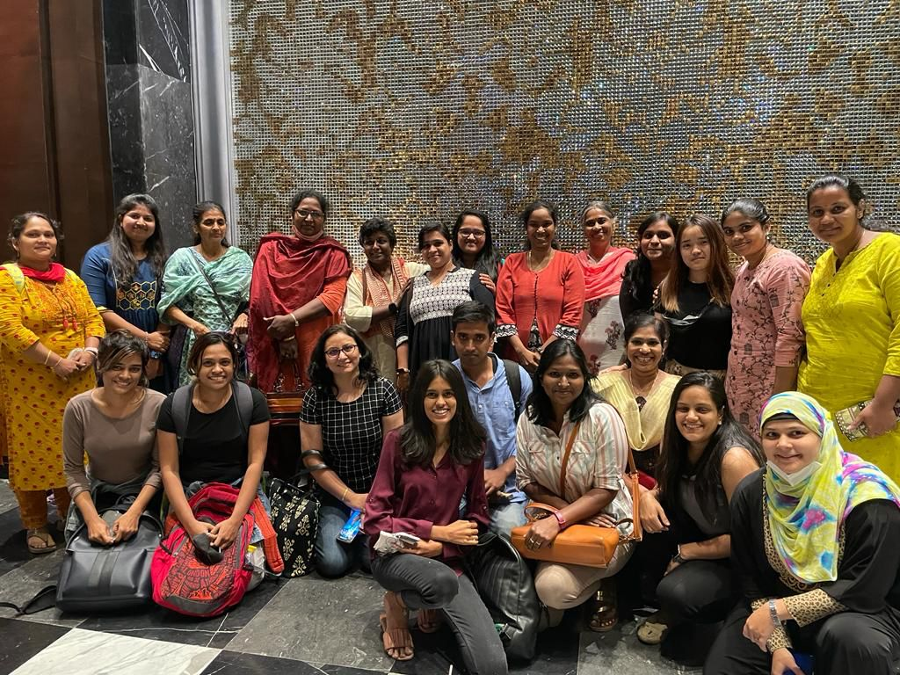
Navadisha is the best place for the people who seek to create a new world for children. Grateful to god that I found it before my life time ends. The mentors taught me humanity and helped me reveal the true nature of myself. At the age of 50, I got the privilege to serve children in a Montessori community. Navadisha is filled with love and positivity and it welcomes everyone wholeheartedly. Hope everyone experienced the same. Wishing my mentors, batchmates and friends good health, peace and happiness.
- NMF 19, Devi Joelpaulmathuram

Slide 24
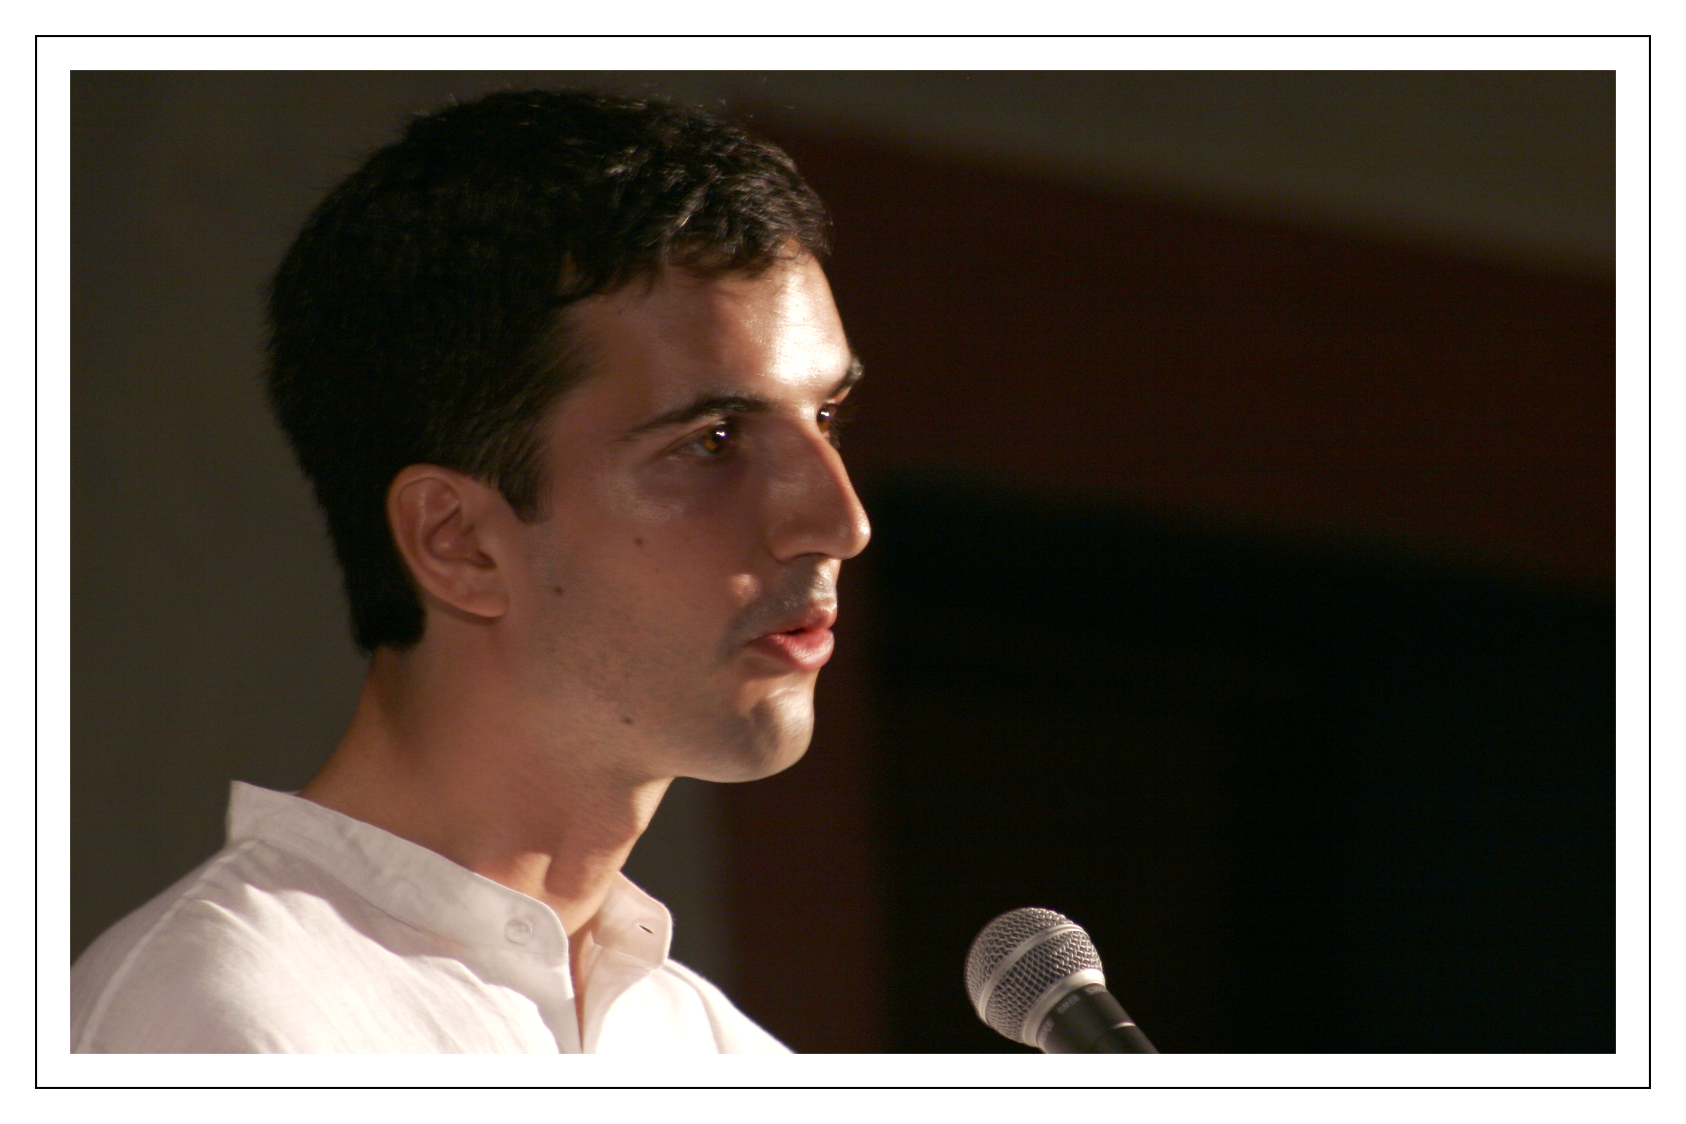
After the course, I moved to Canada, then back to France. I went on to train alongside Ruby and Rukmini, worked in 6-12 and became a trainer, opening the first permanent 6-12 training center in France. For quite a few years, I was dedicated to sending French students to Navadisha, but my dedication faltered in recent years, and I hope my compatriots are still finding their way to the institute. During my graduation speech, I concluded it by addressing the future students at Navadisha, and 17 years later, I’ll send it again : “Listen carefully ! You can still hear the echoes of our laughters, of our tears, of our questions and hopes resounding in the walls. Soon, yours will join ours. And before you can even realize what happened, you'll be standing here in my position, contemplating the future trainees with this weird mix of envy and mercy. But this is another story... As Montessorians, our tale goes on, but as Navadisha students, our story stops here. Let yours start. Enjoy it.” - NMF 02, Hadrien Roche

Slide 25
17 years later, I’m the one who is now handing out diplomas, and I’m still giving speeches at graduations. - NMF 02, Hadrien Roche

