Slide 1
Navadisha Montessori Foundation

Slide 2
We are 20 years old …

Slide 3
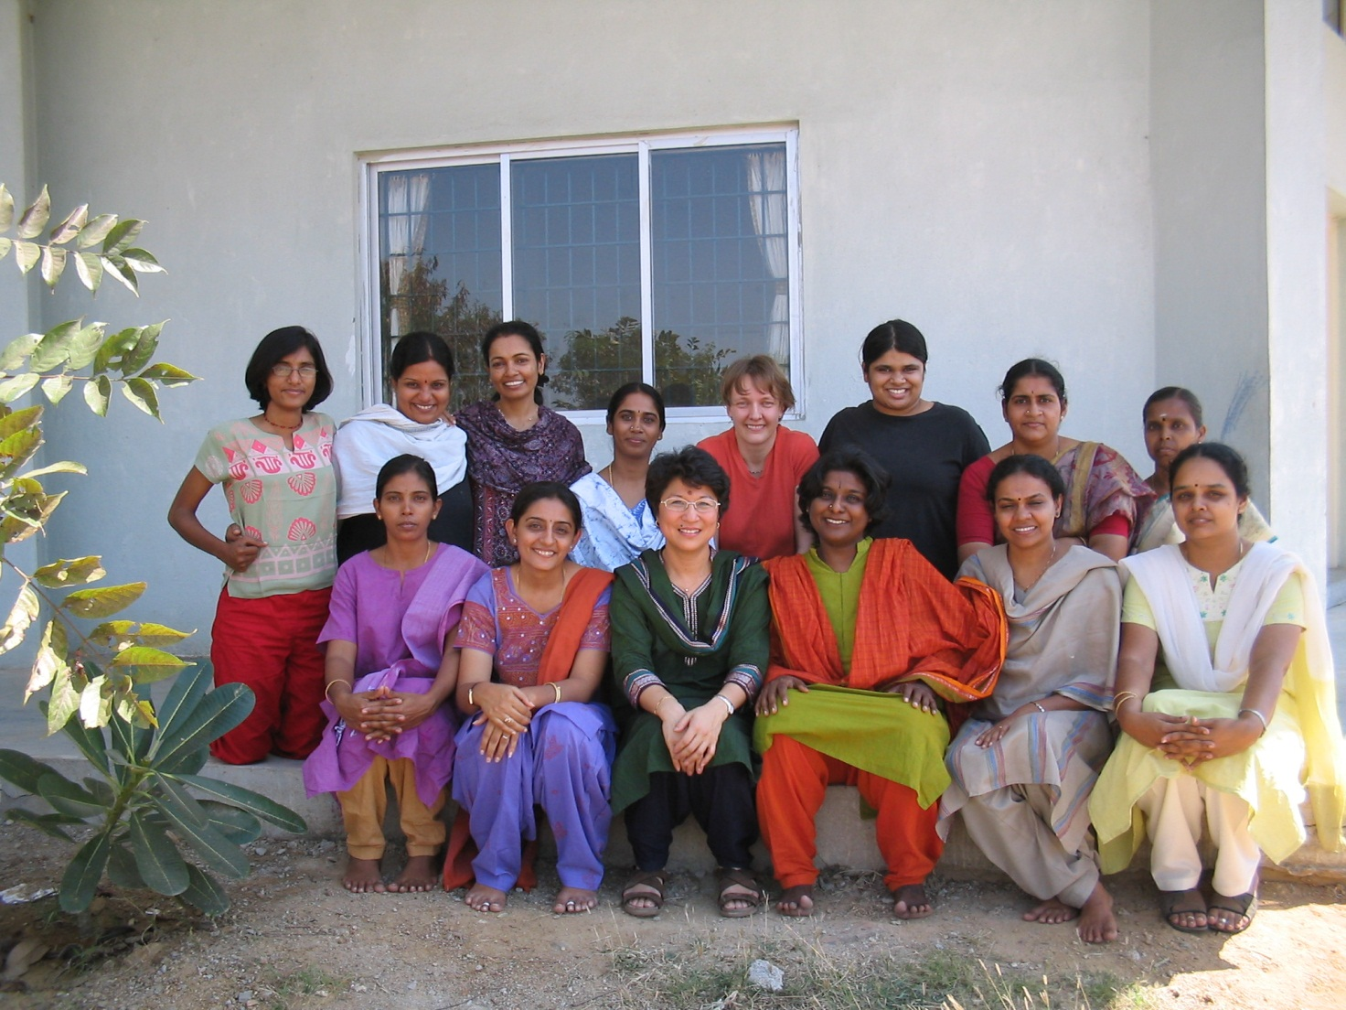
Year 01

Slide 4
The next phase of our development …

Slide 5
A new incarnation…

Slide 6
A new name …

Slide 8
A unit of Abacus Trust …

Slide 9
Moving to new premises …

Slide 10
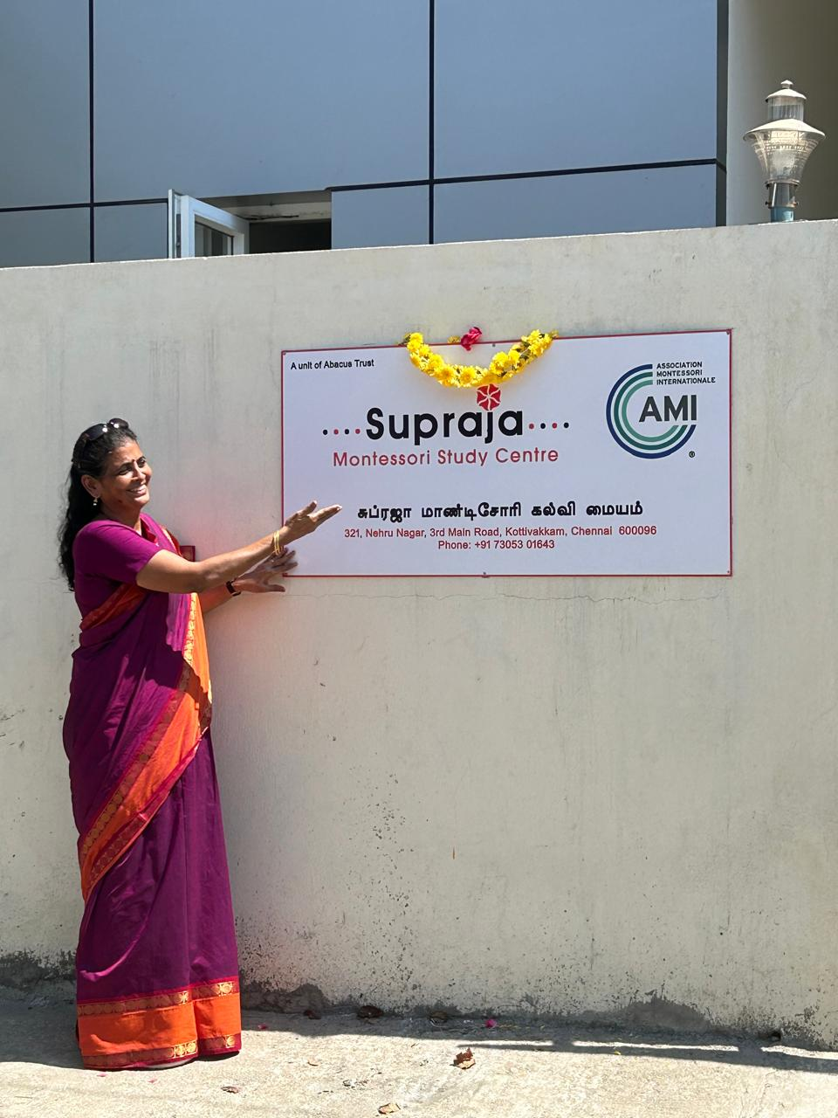

Slide 11
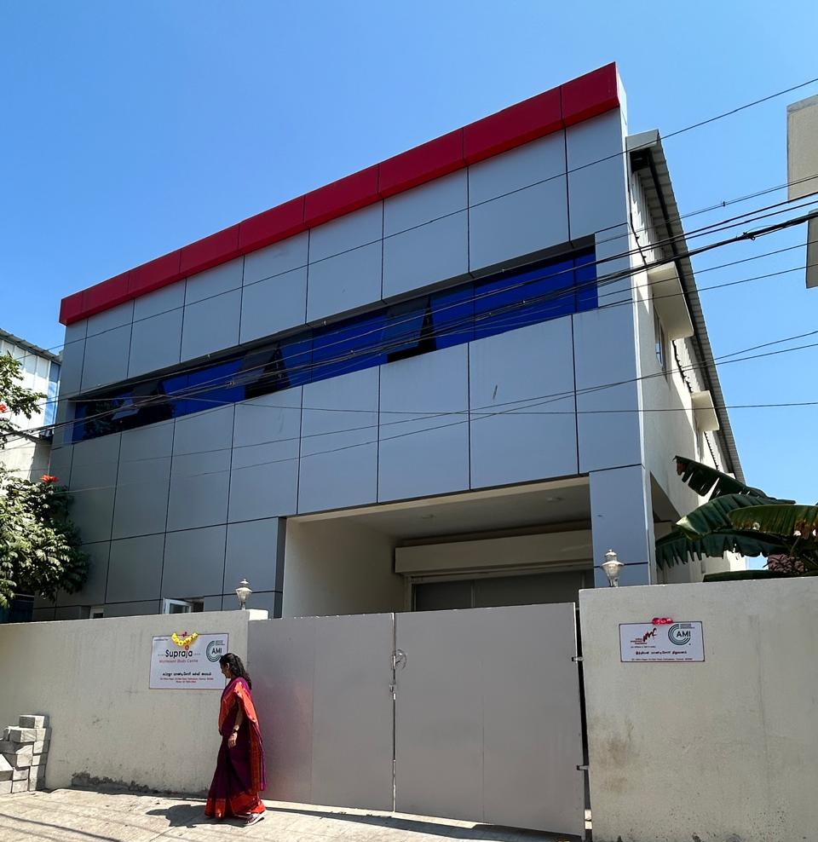

Slide 12
A new independence…

Slide 13
”
My vision of the future is no longer of people
taking exams and proceeding on that certification
from the secondary school to the university, but of
individuals passing from one stage of independence to a
higher, by means of their own activity, through their
own effort of will, which constitutes the inner
evolution of the individual.
~ Maria Montessori

Slide 14
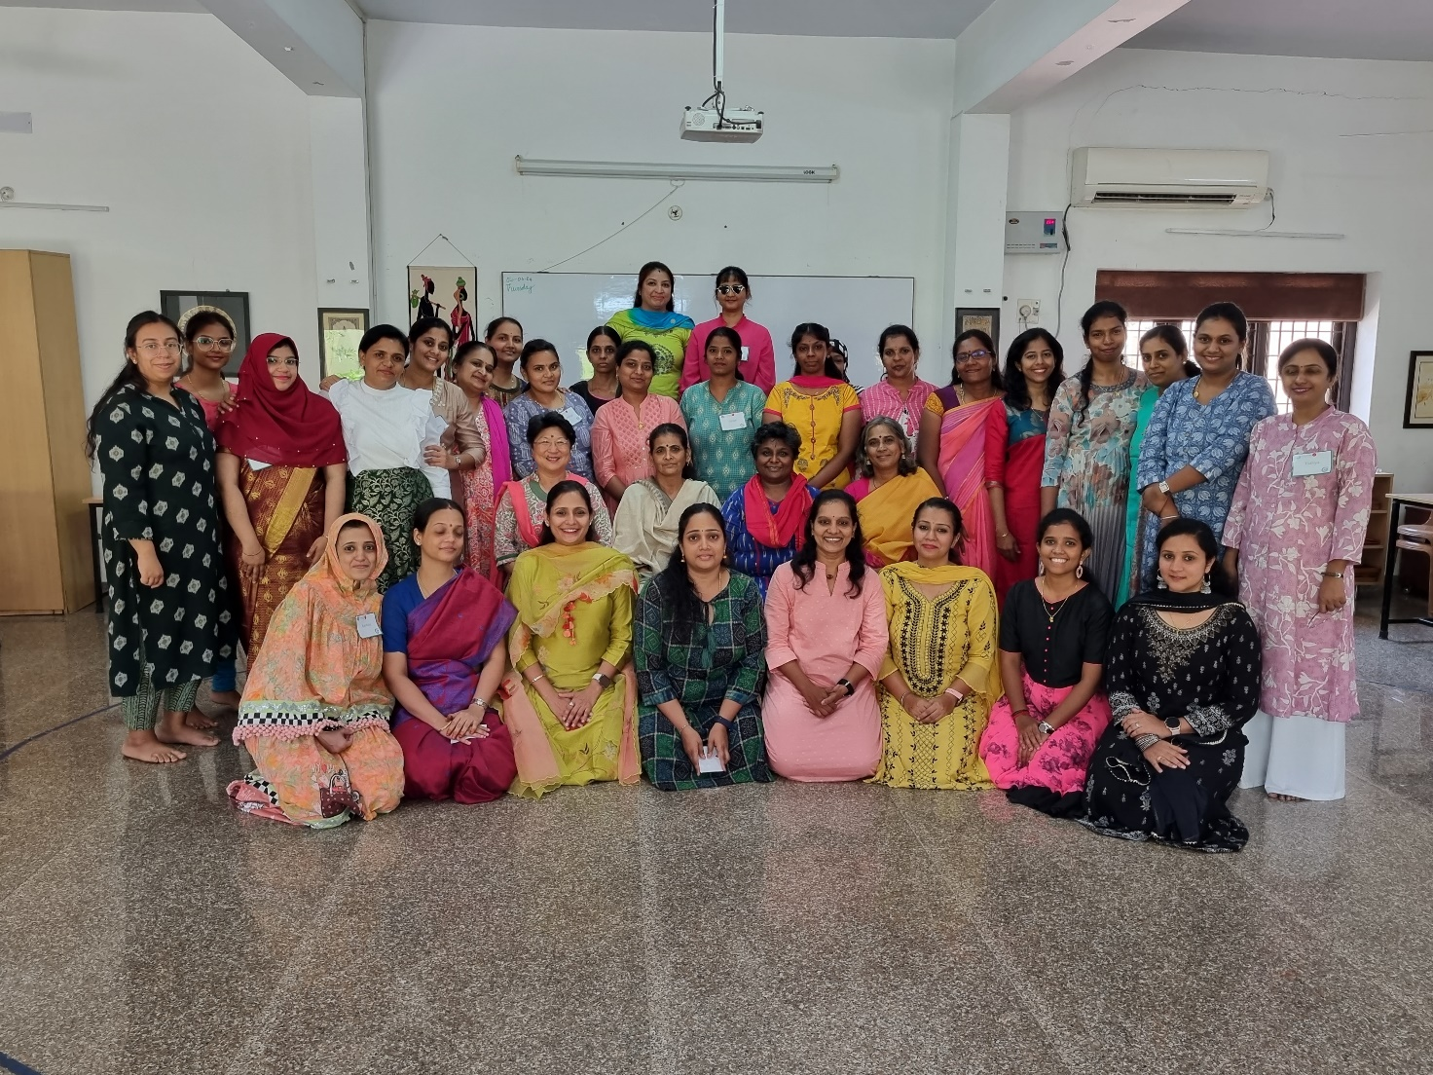
Year 20

Slide 15
20 years and counting …

